Slide 1

School of Computer Science and Engineering
Lovely Professional University, Punjab
Mobile Price Classification
Team members : Harsha Vardhan Tamarana (12005900), Poorna Sri Pavan Teja Tavva (12012967), Sai Rohith Kumar Golem (12001910), Rohit Vardhan Reddy Pininti (12003330), Siddartha Reddy Gedela (12017284), Jaswanth Kumar Reddi (12006714)
Group number : CSERGC0077
Course name : CSE445 (Capstone Project)
Project Supervisor : Aashima (28968)

Slide 2
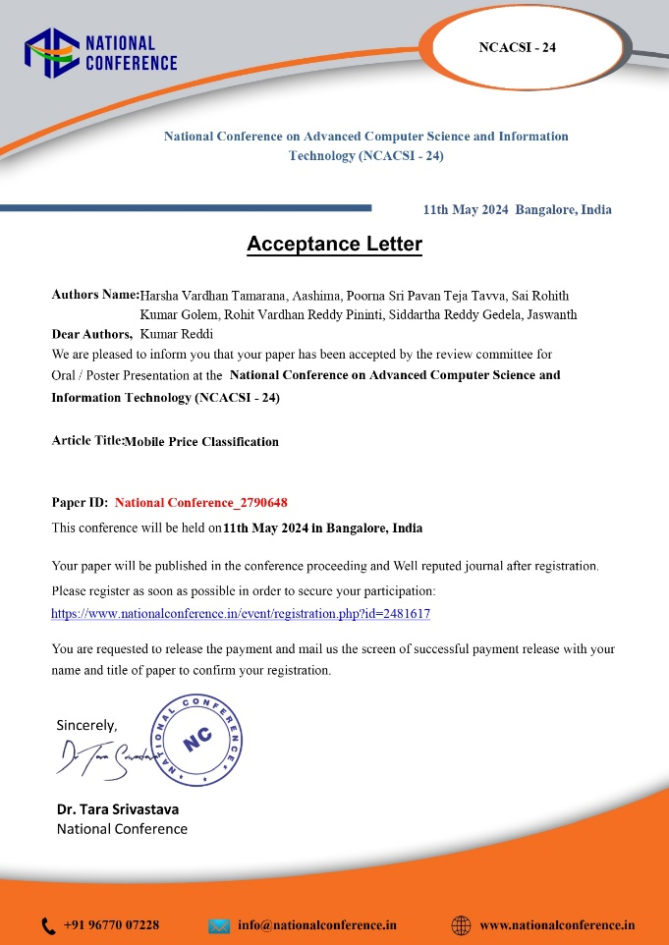
ACCPETANCE LETTER

Slide 3

introduction
Aim
The aim of this study is to explore and evaluate the efficacy of various classification algorithms in predicting mobile phone prices. By delving into the underlying principles and practical applications of these algorithms, the research seeks to provide valuable insights that assist practitioners, researchers, and enthusiasts in making informed decisions in the rapidly evolving field of mobile technology.
Objectives
The objectives of this study include conducting an in-depth analysis of various classification algorithms, assessing their performance in predicting mobile phone prices, and demonstrating their applicability in real-world scenarios. Additionally, the study aims to compare the effectiveness of different algorithms in terms of accuracy, efficiency, and scalability, while offering practical guidance and best practices for implementation.

Slide 4
introduction
Uses
This research has several practical uses, such as enabling businesses to forecast mobile phone prices for strategic planning and competitive analysis, helping consumers make informed purchasing decisions, and assisting retailers in inventory management by anticipating price changes. It also guides manufacturers in pricing new models competitively and provides a foundation for further research in machine learning applications within the mobile technology sector.
Future Scope
The future scope of this research includes enhancing the accuracy and efficiency of classification algorithms, integrating machine learning with other technologies like IoT and blockchain for more robust pricing models, and developing real-time price prediction capabilities. Additionally, there is potential for applying these algorithms to other domains such as electronics, automotive, and real estate, while addressing ethical concerns related to algorithmic decision-making to ensure fair and responsible use of technology.

Slide 5
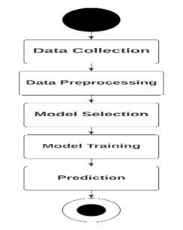
.

Slide 6
Data Collection:
We have collected all the information about the mobile phones that are in the market, and we divided the price
range into 1,2,3. Using this dataset we are going to classify mobiles into 3 classes.
‘battery_power: ’: Represents the battery power of the product/service to which the review pertains.
‘blue': Indicates whether the product has blue screen for eye protection or not.
‘dual_sim': Binary feature indicating whether the mobile phone supports dual SIM cards.
‘n_cores’: The number of CPU cores in the mobile device.

Slide 7
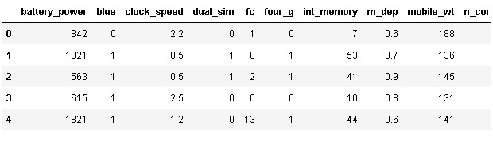
ABOUT THE DATASET

Slide 8
Data Preprocessing:
We did check all the outliers in the dataset, and we looked for the missing values by performing and plotting different graphs.
From Fig. 1 we can see that there are very less outliers in the model nearly 2 to 3 which will not affect our outcome of the models.
Checking the relationship between the data:
As mentioned in Fig. 2 plotting a Scatter plot for Price range and RAM to check if there is any relation between them, similarly we have plotted scatter plots for various column names like cores, cameras, battery power, and blue.
As mentioned in Fig. 3 We found no relation between n_cores and price_range.

Slide 9
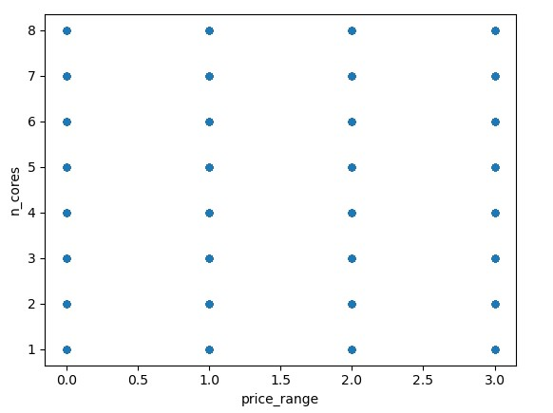
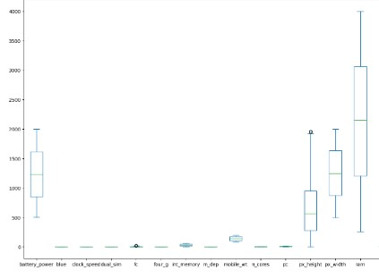
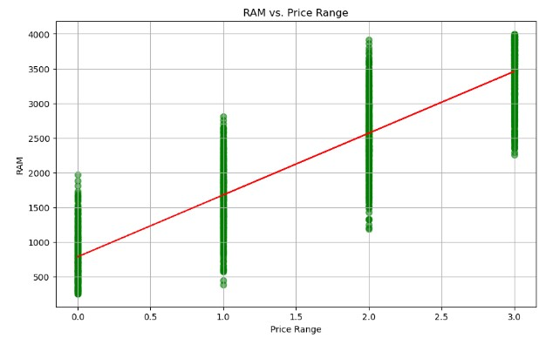

Slide 10
MODEL SELECTON
The model selection process involved exploring various machine-learning algorithms, encompassing.
Logistic Regression
Decision Tree
KNN
Random Forest
SVM
GBM
NN (Neural Network)
Naive Bayes
Gaussian Process
XG Boost
Light GBM
Extra Trees

Slide 11
Model Evaluation
To assess the performance of the trained model it is evaluated on the test dataset. Both SVM and Logistic Regression offer a measure of a predictor’s appropriateness (coefficient size) as well as the association’s direction (positive or negative), which aids in the evaluation of the model.
They are compared with other algorithms based on various model evaluation techniques as mentioned in Table 1.
These methods assess model performance using a test set. It is not advised to evaluate the model using the same data that were used to generate it. This makes it easier to determine whether the model is reliable and functional.
The performance of different machine learning algorithms is compared to identify the most effective approach for mobile price classification.

Slide 12
. Prediction
The model is used to forecast customer attrition on new data after it has been trained and evaluated. Using the input features of new consumers, the trained model predicts whether or not they would churn.
Algorithm | Accuracy (%)
Decision Tree | 83.25
KNN | 52.25
Logistic Regression | 96.00
Random Forest | 92.40
SVM | 96.00
GBM | 88.25
NN (Neural Network) | 92.00
Naive Bayes | 76.00
Gaussian Process | 91.00
XG Boost | 90.00
Light GBM | 88.00
Extra Trees | 84.00

Slide 13
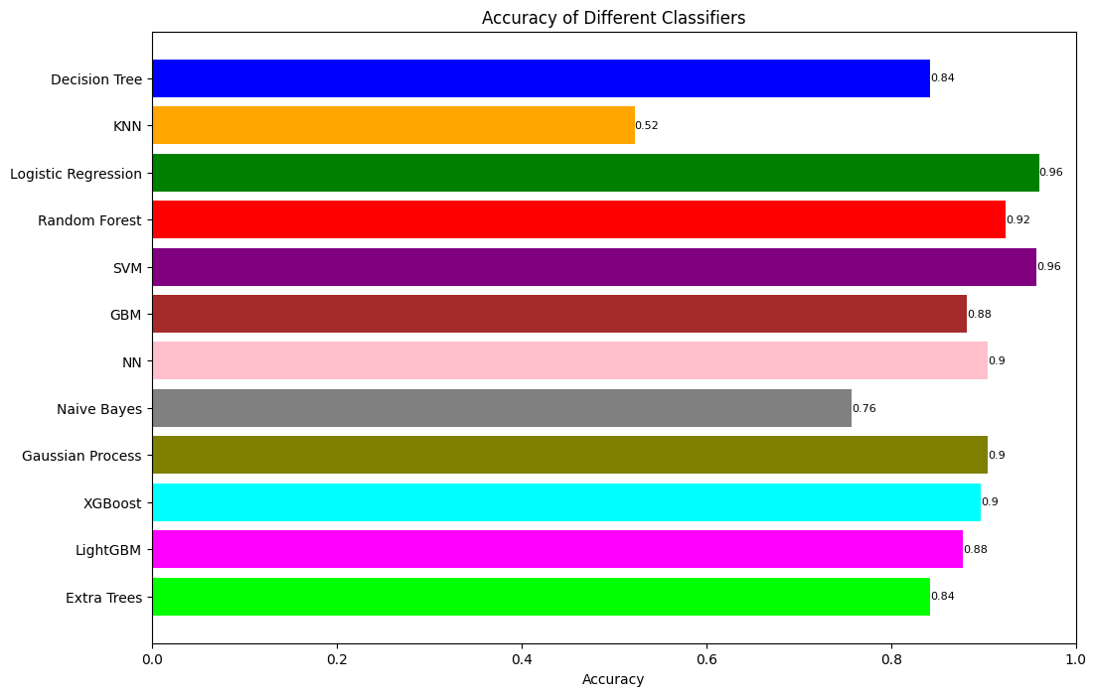
RESULTS AND ANALYSIS

Slide 14
CONCLUSION
Our research into predictive modeling for mobile phone price classification revealed that support vector machines and logistic regression were the most effective, both achieving a 96.00% accuracy rate. Despite lower accuracy, models like Naive Bayes and KNN also offered valuable insights.
This study underscores the importance of machine learning in addressing practical issues, aiding consumers in decision-making, and informing manufacturers' marketing and product development.
Continued exploration and refinement of these models will drive advancements in predictive systems for future mobile technology.

Slide 15
FUTURE SCOPE
Future research in predicting mobile phone prices can significantly benefit from advanced machine learning techniques like ensemble learning and deep learning, enhancing model precision and robustness.
Incorporating a wider range of variables such as user sentiment, economic indicators, and technological trends can improve predictive accuracy. Collaboration between data scientists, industry experts, and manufacturers can lead to tailored, effective models.
Continuous updates to these models will be necessary to keep pace with the fast-evolving mobile technology landscape. Embracing new technologies and interdisciplinary collaboration will drive future advancements in this field.

Slide 16
REFERENCES
[1]S. Subhiksha, Swathi Thota & J. Sangeetha, Prediction of Phone Prices Using Machine Learning Techniques1, Part of the book series: Advances in Intelligent Systems and Computing ((AISC, volume 1079)), January 9, 2020.
[2]Jinsi Jose, Vinesh Raj, Sweana Vakkayil Seaban & Deepa V. Jose Models Machine Learning Algorithms for Prediction of Mobile Phone Prices2 Part of the book series: Lecture Notes in Networks and Systems ((LNNS, volume 537)), August 1, 2023.
[3]K. T. Chandrashekhara, M. Thungamani, C. N. Gireesh Babu & T. N. Manjunath, Smartphone Price Prediction in Retail Industry Using Machine Learning3 2019 Part of the book series: Lecture Notes in Electrical Engineering ((LNEE, volume 545)), April 24.
[4]Mrs. Sugur Swathi, Dr. SubbaRao Kolavennu, Raja Rajeswari Mulagandla, Devika Chowdary Sajja, Sruthi Ale, Classification of Mobile Phone Price Dataset using Machine Learning1, ISSN:2457-0362, Volume 13, Issue 06, June 2023.

Slide 17
REFERENCES
[5]Thomas Rincy N, Roopam Gupta, “An efficient feature subset selection approach for machine learning”, Multimedia Tools and Applications, Jan 2021.
[6]A.N.M. Bazlur Rashid, Choudhury T, “Knowledge management overview of feature selection problem in highdimensional financial data: cooperative co-evolution and MapReduce perspectives”, Problems and Perspectives in Management, vol 17, pp.340-359, Dec 2019.
[7]Rashid AB, Mohiuddin Ahmed, Leslie F. Sikos & Paul Haskell-Dowland,” Cooperative co-evolution for feature selection in Big Data with random feature grouping”, Journal of Big Data, Dec 2020.
[8]Usmani, M., Adil, S.H., Raza, K., Ali, S.S.: Stock market prediction using machine learning techniques. In: 2016 3rd International Conference on Computer and Information Sciences (ICCOINS), pp. 322–327. IEEE (2016).
[9]Jayaraman, S., Choudhury, T., Kumar, P.: Analysis of classification models based on cuisine prediction using machine learning. In: International Conference on Smart Technologies for Smart Nation (SmartTechCon) pp. 1485– 1490. IEEE (2017).

Slide 18
thank you

